Slide 1
Speech Emotion Recognition

Slide 2
Objective
The objective is to make a machine learning model which can classify speech into various categories of emotions.
The application of the speech emotion recognition system include the psychiatric diagnosis, intelligent toys, lie detection, in the call centre conversations which is the most important application for the automated recognition of emotions from the speech, in car board system where information of the mental state of the driver may provide to the system to start his/her safety

Slide 3
Common Technique
Input
Feature Extraction
Classification
Output
Audio files in .wav, .mp3 format
Pitch
Speech Energy
MFCC
Mel
Simple classification algorithms:
SVM
KNN
Random forest
Gradient Boosting
Extra trees
Using Deep learning:
CNN
CNN+LSTM
The different emotion to which the audio files belong.

Slide 4
Speech Corpus
Ryerson Speech database has been used. This dataset contains 1440 files(60 trails per actor x 24 actors), total size = 215 MB classified into 8 different classes, namely angry, calm, disgust, happy, fearful, sad, surprised and neutral. The first 7 of them contains 192 files, whereas neutral contains 96 files in .wav format. Each file has a unique filename made up of 7-part numerical identifiers (e.g., 02-01-06-01-02-01-12.wav).:
Filename Identifiers:
Modality (01 = full-AV, 02 = video-only, 03 = audio-only).
Vocal channel (01 = speech,ach 02 = song).
Emotion (01 = neutral, 02 = calm, 03 = happy, 04 = sad, 05 = angry, 06 = fearful, 07 = disgust, 08 = surprised).
Emotional intensity (01 = normal, 02 = strong). NOTE: There is no strong intensity for the 'neutral' emotion.
Statement (01 = "Kids are talking by the door", 02 = "Dogs are sitting by the door").
Repetition (01 = 1st repetition, 02 = 2nd repetition).
Actor (01 to 24. Odd numbered actors are male, even numbered actors are female).

Slide 5
Feature Extraction
‘pyAudioAnalysis’ is used to extract audio features, train and apply audio classifiers, segment an audio stream using supervised or unsupervised methodologies and visualize content relationships. The total number of features implemented in pyAudioAnalysis is 34 which includes Zero Crossing Rate, Energy, Entropy of Energy, Spectral Flux, MFCCs, Chroma Vector etc. The library is written in Python, which is a high-level programming language that has been attracting increasing interest, especially in the academic and scientific community during the past few years

Slide 6
Classifiers Used
Classifier Type | Accuracy
SVM | 51%
KNN | 55%
Gradient Boosting | 47%
Random Forest | 52%
Extra Trees | 54%

Slide 7
USING DEEP LEARNING

Slide 8
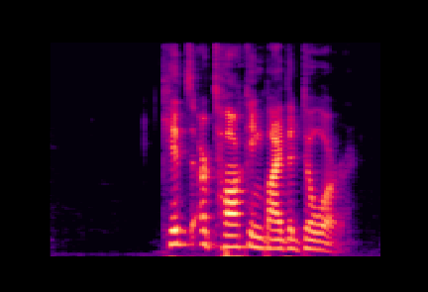

Preprocessing
Initially, all audio files are cropped to same length.
Mel and mfcc spectrograms are generated using the functions implemented in the librosa library of python.
These spectrograms generated are used as an input for the CNN.
Mel Spectrogram
MFCC Spectrogram

Slide 9
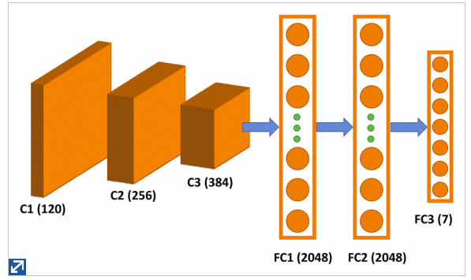
Architecture
The CNN model consist of three convolutional layers(with maxpooling), two fully connected layer and a softmax layer. The input of the network is 128x128. Non-linear activation function such as ReLU is used. In order to avoid overfitting the fully connected layers are followed by dropout layers.
32x32x64
64x64x64
128x128x32
FC3 (8)
FC1 (16384)
FC2 (128)

Slide 10
Result:
The resultant network was trained on RYERSON data using ‘adam’ optimiser and ‘categorial crossentropy’ as a loss function.
When the network was trained on 50 epochs, we achieved an accuracy of about 57%.

Slide 11
Data Augmentation
Why?
The data available in the speech corpus was not sufficient enough to train the deep learning model. So we decided to augment the data so that the size of the database can be increased.
The data augmentation was done by varying the following parameters:
Pitch - The pitch is increased or decreased by few semitones.
Speed - The audio is slightly stretched or compressed
It helped us to generate a total of 15840 files belonging to 8 different classes.

Slide 12
Training and Result
The augmented data along with the original data is splitted into 75:25 train, test ratio and trained on the same CNN model for 100 epochs.
It achieved an accuracy of about 86%

Slide 13
CNN+LSTM
The two fully connected layers in the CNN model are replaced by two LSTM layers comprising of 50 and 20 nodes respectively.
The model achieved an accuracy of 92%.

Slide 14
Conclusion
Use of CNN-LSTM model for recognition of emotion from speech is a effective step towards designing a generic emotion recognition system. Although the size of data set is not so large the performance of our proposed model is promising enough. Some normalized input data or use of Bidirectional LSTM instead of LSTM can lead to us more better solution. Also the training will produce more convenient outcome if we can feed a larger set of data to the system.

Slide 15
ENJOY DEEP LEARNING

